Slide 1
McCoys Creek- the time is right

Slide 2
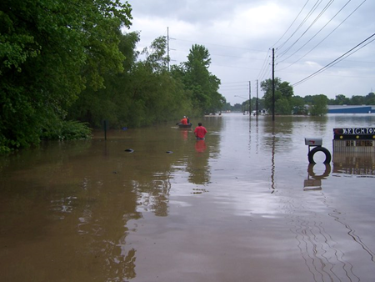
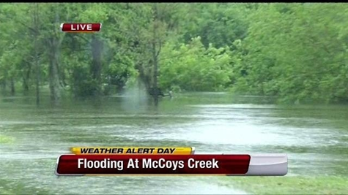
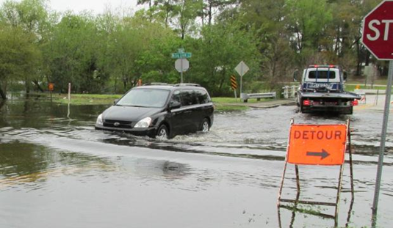
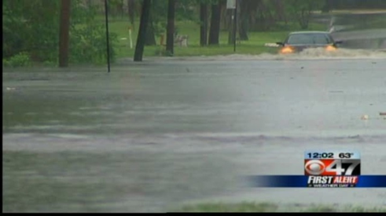
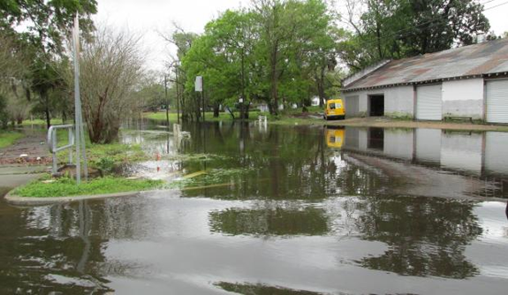
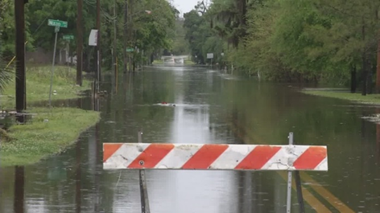
Not only hurricanes, but every heavy rain event presents a problem

Slide 3
A decade old Stormwater Management and Flood Mitigation Plan- defined two independent sections (E and W of Myrtle) with independent projects and benefits
The Local Mitigation
Strategy lists this project as the #1 Jacksonville Project

Slide 4
Cleanup & re-stabilization of the creek banks (as well as adjacent parcels) is required by our Ash Clean-up agreement

Slide 5
The greenway trail is our priority project at the TPO and in our CIP

Slide 6
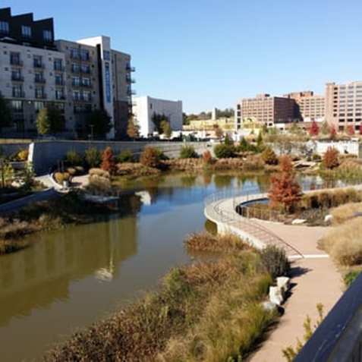
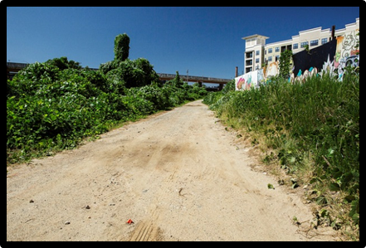
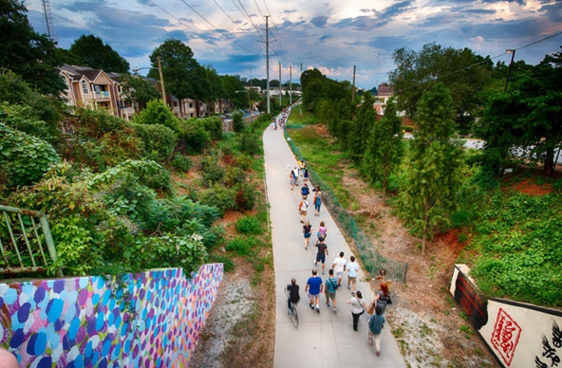
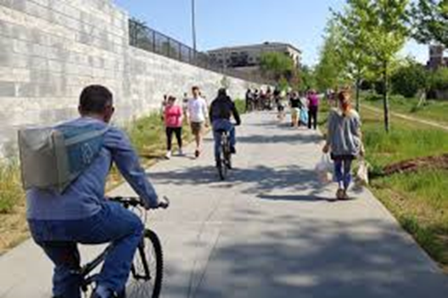
The Vision- west of Myrtle (think Atlanta Beltline)
Before
After

Slide 7
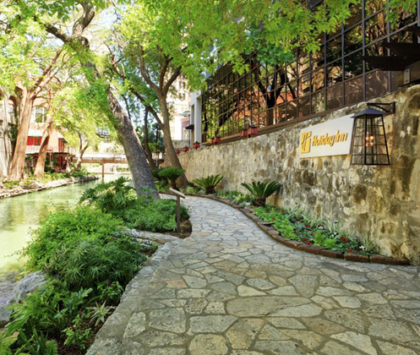
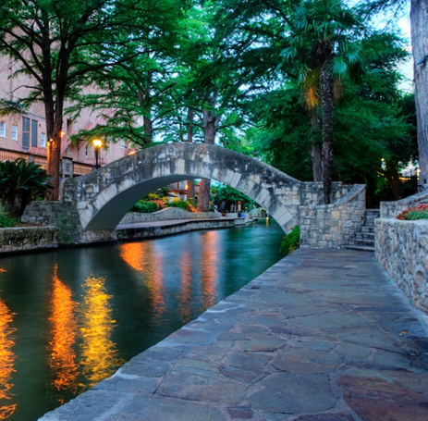
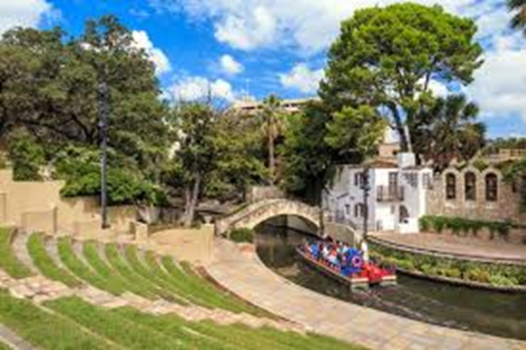
The Vision East of Myrtle (Think San Antonio waterfront)

